Slide 1
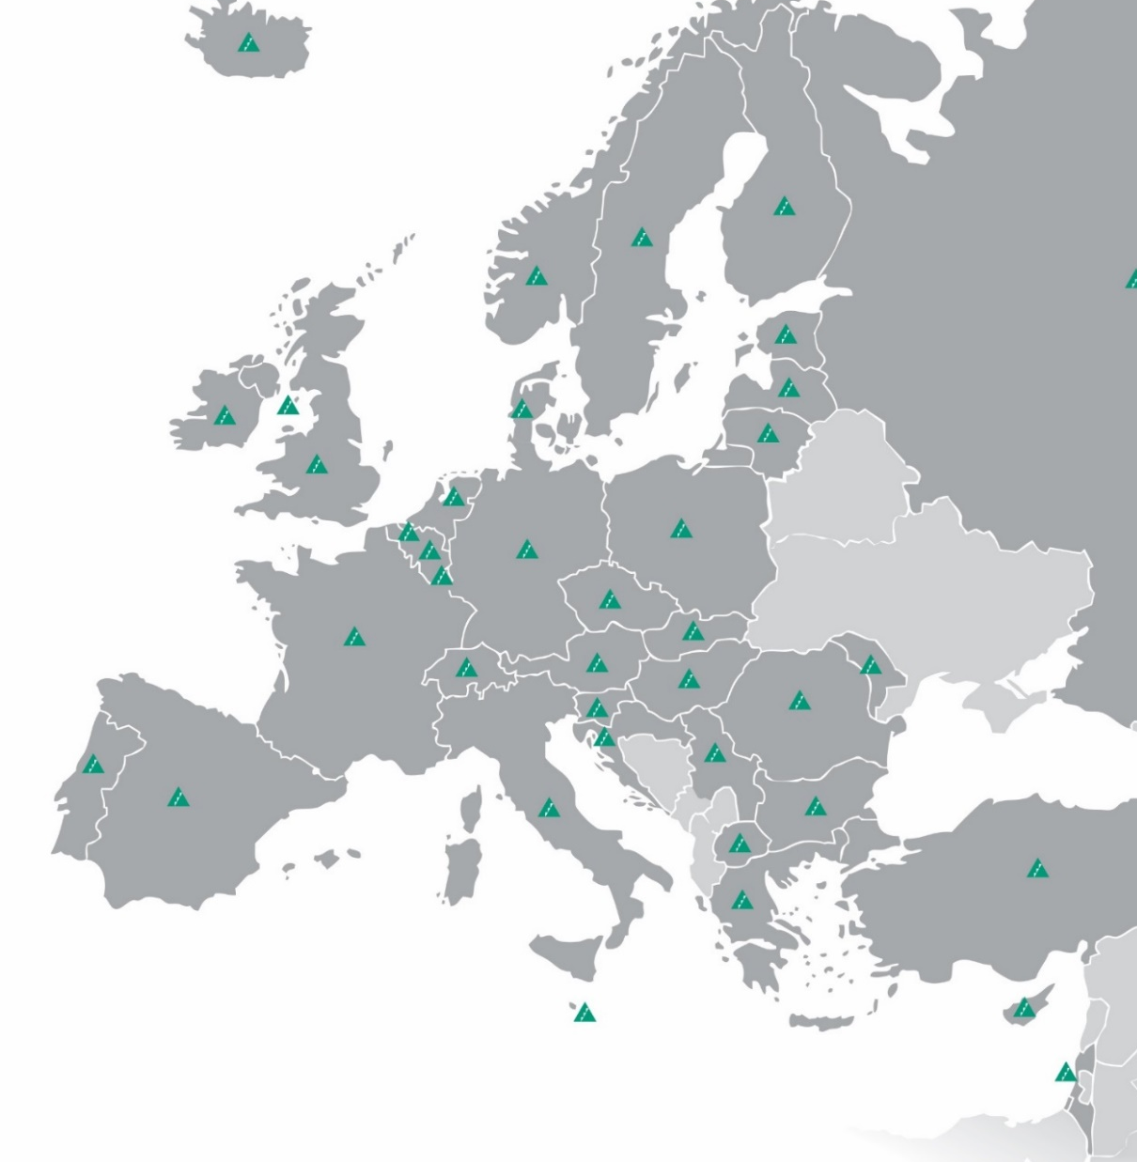
www.y-e.org.uk
http://jaeurope.org
https://www.jaworldwide.org
Notes:
Young Enterprise is the UK’s leading charity that empowers young people to harness their personal and business skills. At Young Enterprise our vision is that every young person has the opportunity to learn the vital skills and enterprising mindset needed to earn and look after their money and make a positive contribution to their community.
At Young Enterprise our vision is that every young person has the opportunity to learn the vital skills and enterprising mindset needed to earn and look after their money and make a positive contribution to their community.
Our mission is to empower young people to discover, develop and celebrate their skills and potential.

Slide 2
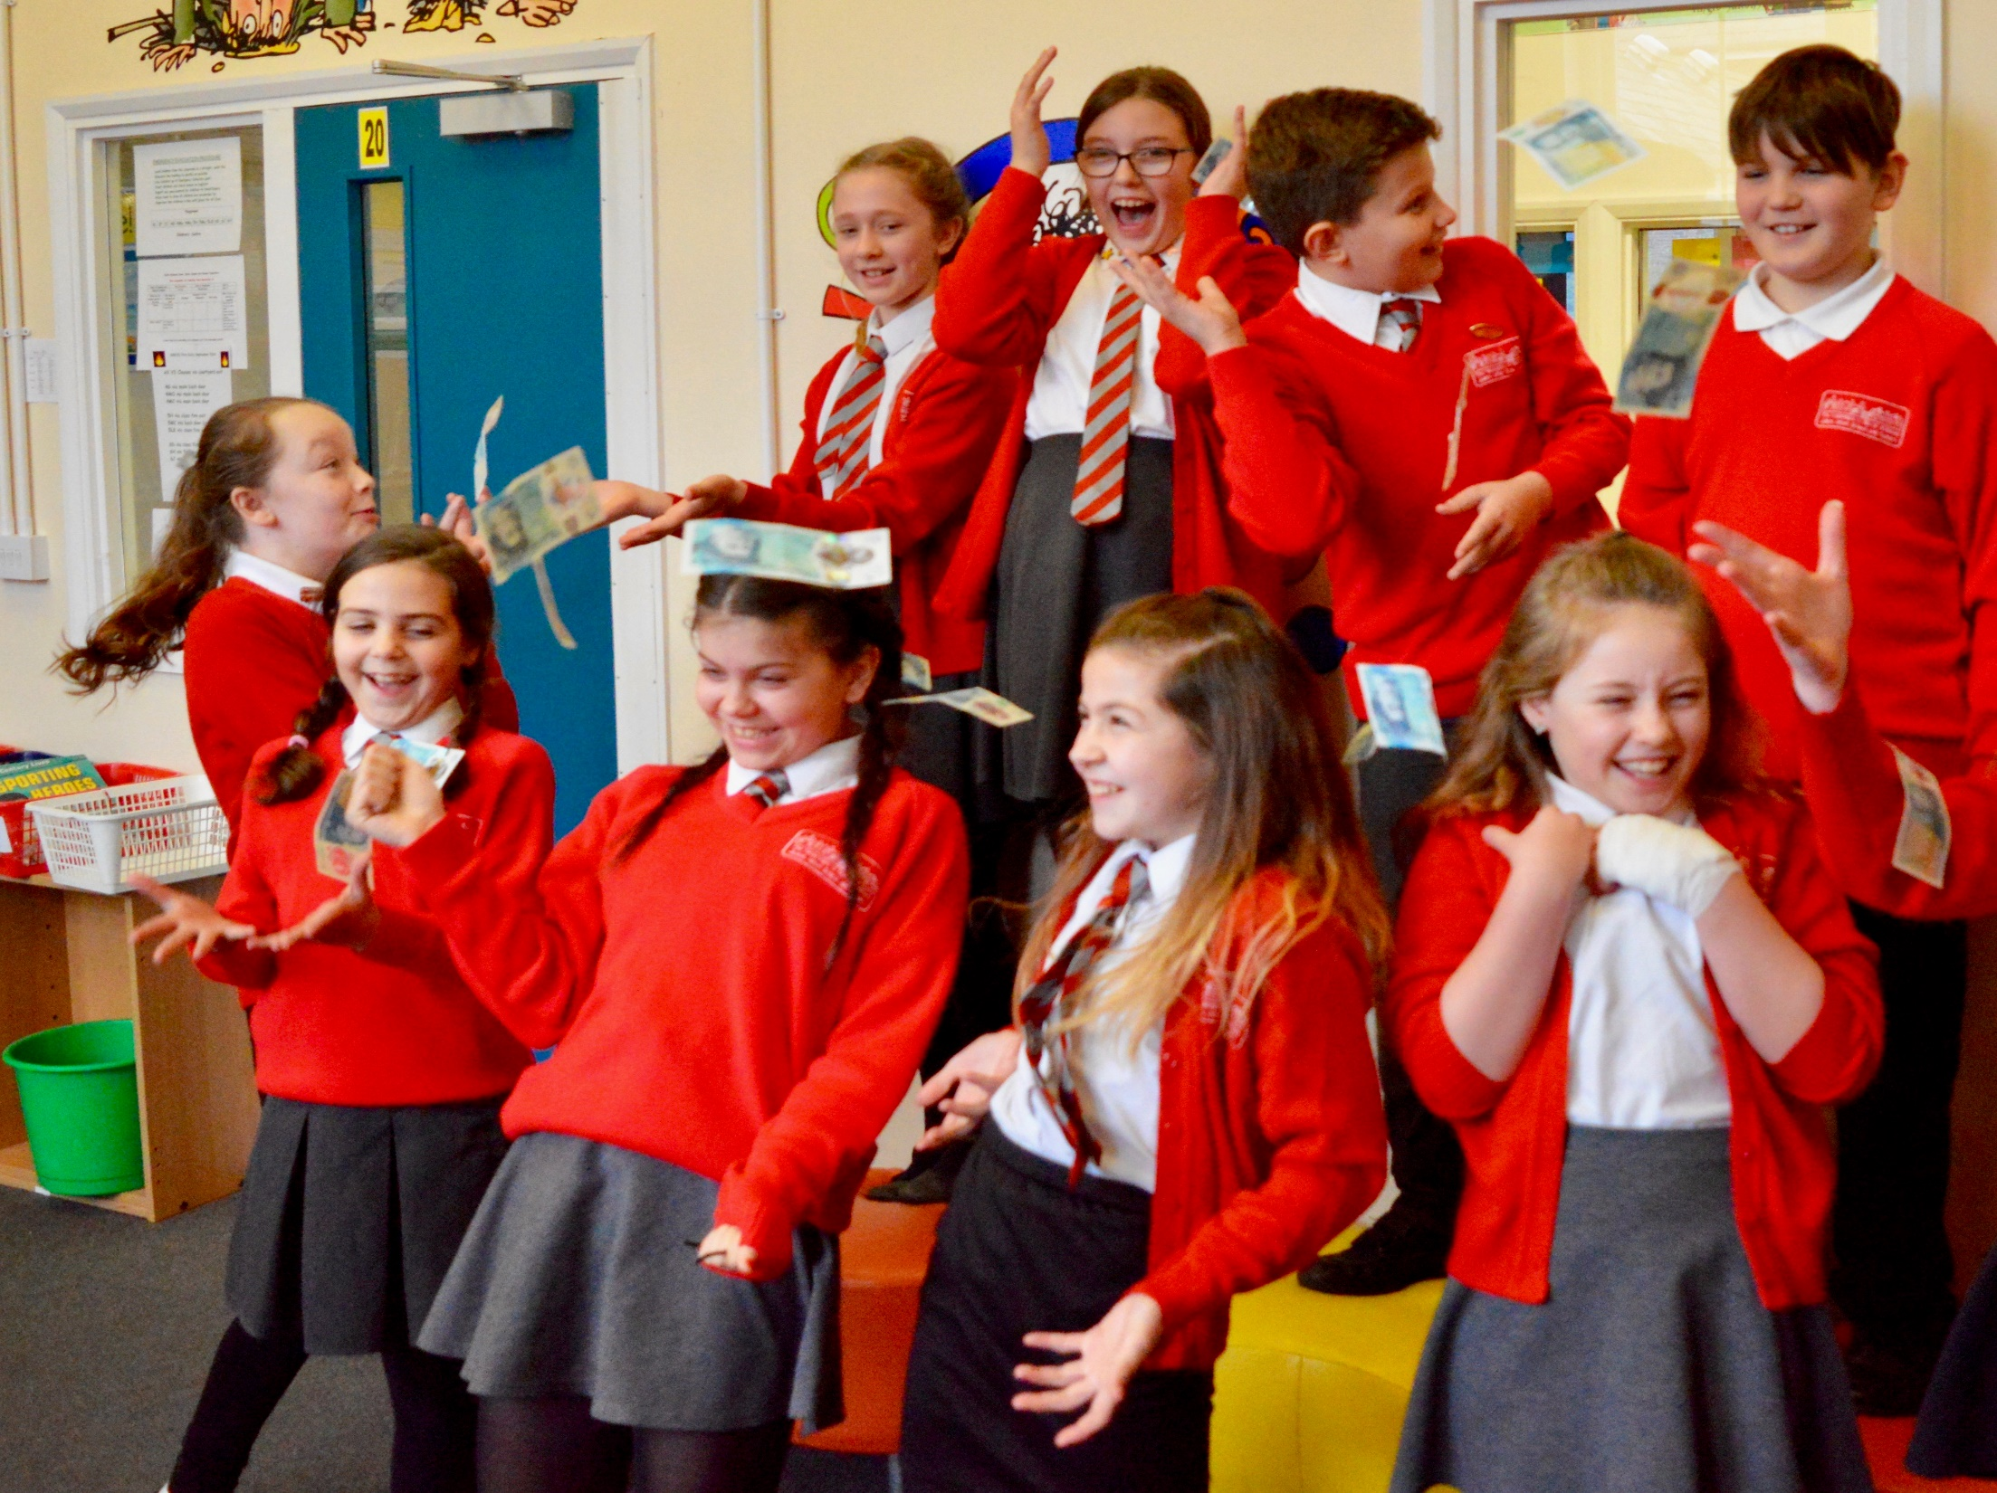
Introducing Entrepreneurship and the Fiver Challenge

Slide 3
Fiver introduction
Session 1
What is an entrepreneur?
Examples of young entrepreneurs
Session 2
What is the Fiver Challenge?
Starting your Fiver Business
Competitions
Notes:
Briefly introduce each session
Up to 5 minutes

Slide 4
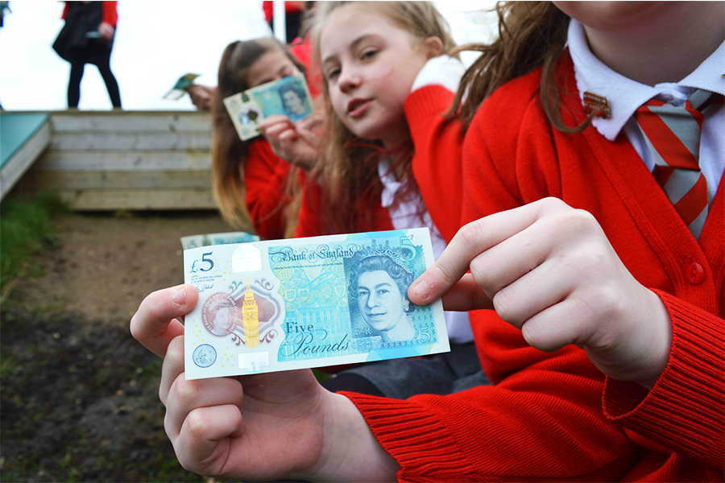
Session 1
What’s an Entrepreneur?

Slide 5
What is an Entrepreneur?
An entrepreneur is a person who sets up a business or businesses with the goal of making a profit. One example is Bill Gates who owns Microsoft.
Key business terms:
Revenue is the money you make by selling your product or service e.g. if you sell a cake for £3 your revenue is £3.
Costs are anything you spend money on to make your good or service e.g. if you are making cakes your costs would be the ingredients.
Profit is the extra money you have left over from selling your product or service once you have taken away the money spent to make your product or deliver your service. In other words, your revenue minus your costs.
Notes:
Ask students to discuss other entrepreneurs they know.
Remember if you ever see a word you don’t know you can look it up in the Fiver Word Guide.

Slide 6
But what makes a successful
entrepreneur?
5 common characteristics of a successful entrepreneur:
Motivation and confidence
A good eye for opportunities
Happy to take risks
Can learn from mistakes
Trust in and respect for their colleagues
Notes:
Ask the young people for any other characteristics they think an entrepreneur would have.

Slide 7
Young Entrepreneur
Treandos Thornton
Notes:
Now that we know what an entrepreneur is and some of their characteristics let’s look at a real life example of a successful entrepreneur who is making a difference in his hometown at the age of 8 years old.

Slide 8
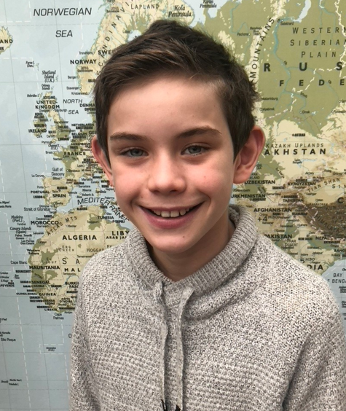
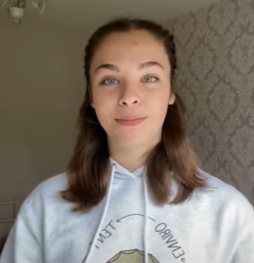
YE Entrepreneurs in 2020
Notes:
Let’s have a look at some of the entrepreneurs that took part in Young Enterprise programmes:
Sam (left) – As part of his Fiver Challenge Sam decided to create personalised recyclable masks for the VE day celebration to ensure that his community to celebrate together safely, aged just 10 years old.
Tayla Evans (right) – was the MD of EnviroTent who won the Company of the year award whilst taking part in the Company Programme. We will look at what EnvoriTent did a little later on.

Slide 9
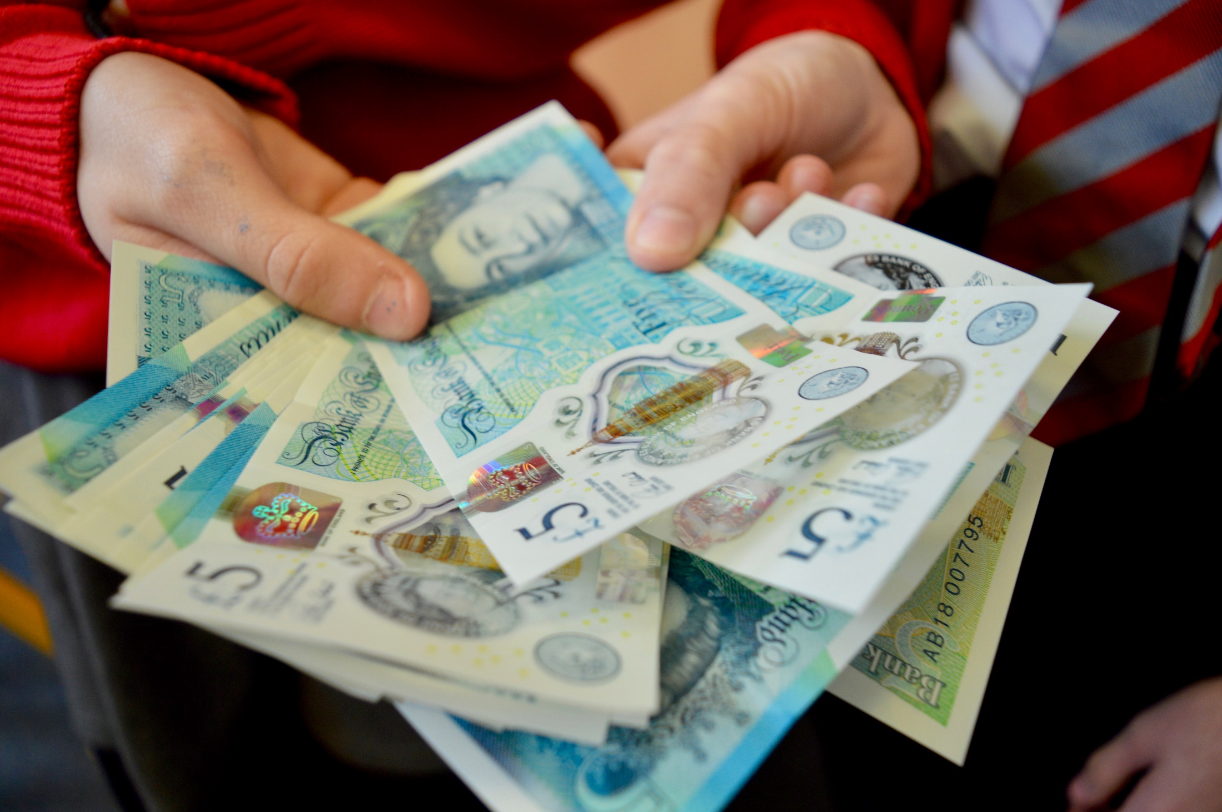
Session 2
Getting ready to take the Fiver Challenge

Slide 10
What is the Fiver Challenge?
With just a £5 initial investment and 4 weeks, teams have to create, market, organise and financially manage their own business with the intention of making a profit.
How does it work?
You can choose to work in a team of up to 8 or individually
There are 2 weekly competitions to enter and a National Competition
At end of the Challenge, you pay back your £5 plus a £1 legacy if you make a profit to help keep Fiver going
The profit is yours to keep and it’s up to you to decide how to spend it
In 2021 the Challenge will run from Monday 7th June – Friday 2nd July
Notes:
Definition explanation: An investment is when people give money, usually to businesses, so that they can grow.
The legacy from those who make a profit goes to the ‘Fiver bank’ which helps us provide funding to schools in the future.

Slide 11
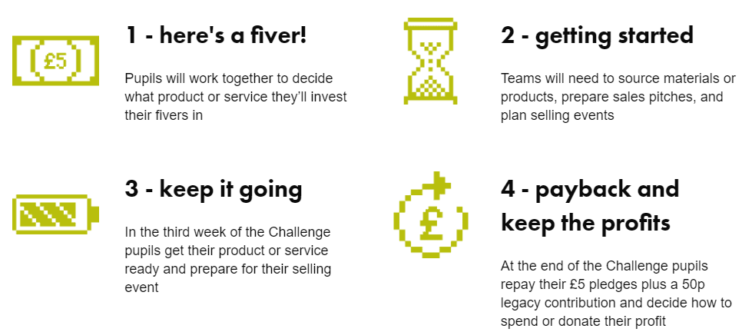
Keeping you on track throughout the Challenge
You will be following the 4 week plan below and there are lots of fun activities so you can start your own business!
Notes:
To support this slide please read the 4 week plan which explains in detail what young people will be doing.

Slide 12
Sustainability
In the Fiver Challenge we encourage a sustainable approach to business rather than thinking solely of profit.
What does sustainability in business mean?
“A business which operates today in a way that values and protects the people, planet and resources it relies on for the future’’
Remember - big change starts small!
Notes:
Whilst profit is an important aspect of running a business as it will allow you to grow if you invest the money properly there are other key aspects.
In the mid-1990s, John Elkington produced a new way of measuring business results--the 'triple bottom line'. Going beyond £££, this includes environmental and social impacts. It is sometimes known as "People, Planet, Profit".
Your Fiver business is sustainable if it is:
Protects the planet e.g. reduces air miles by using local resources
Or cares for communities e.g. pays a fair price to suppliers
Profitable and aims to satisfy a need
An example of one way a Fiver business can achieve this is to spend time researching to select suppliers who operate as sustainably as possible. One way to do this would be to make sure you use eco-friendly packaging to reduce plastic consumption.

Slide 13
United Nations Sustainable
Development Goals
Notes:
The Sustainable Development Goals (SDGs) also known as The Global Goals are a shared agenda to end poverty, fight inequality & injustice and protect the planet. Agreed in 2015 by all countries within UN and set to be completed by 2030.
Are there any ways to focus on sustainability with your Fiver business idea/service? If so you could be in with a chance of winning the ‘Best in sustainability’ prize in the National Competition.

Slide 14
Example of a sustainable business
Notes:
A great example of a sustainable business is 2020’s ‘Company of the Year’ award winner was EnviroTent.
Having seen the waste that plastic tents decided to create the first ever cardboard only tent that whilst having all of the water and windproofing of a regular tent is fully recyclable.
They showed a great ability to spot a business opportunity whilst solving a common issue seen across festivals in an eco-friendly way.
Let’s have a look at how they approached their business.

Slide 15
Your Fiver idea:
How will you choose what you do?
Product
Handmade or home grown? Personalised?
Can you link it to a topic or theme, event or a local opportunity?
Service
Using your team to create/offer an activity for a fee
Examples : car washing/dog walking
How can you make sure you profit from your £5?
Notes:
Getting started…
Firstly, you’ll need to think of what you will be selling – will it be a product or service? You must make sure that the business you create is in the rules of the Fiver Challenge. (Teachers please refer to the Product Guidelines sheet)
To make a profit from your product or service you will need to add value to your product or service.
Added value is the difference between the cost of inputs (what you put in) and the price customers are willing to pay.
2 ways to add value are:
Reducing your costs e.g. using vegetables from your own garden is free
Another way is to have a high price e.g. products and services that are in high demand tend to be more expensive – remember not to make them too expensive as people won’t buy it!
Find out more from your customers - Market research is a great way to find out what potential customers think of your product or service.
Now you have your business idea and know that it will make a profit and customers will buy it you will need to move onto your business plan.

Slide 16
What business name will you
choose for your business?
Notes:
Choose a name and logo that:
Says what the business does
Is memorable
Is unique! – we don’t want copyright or brand infringements

Slide 17
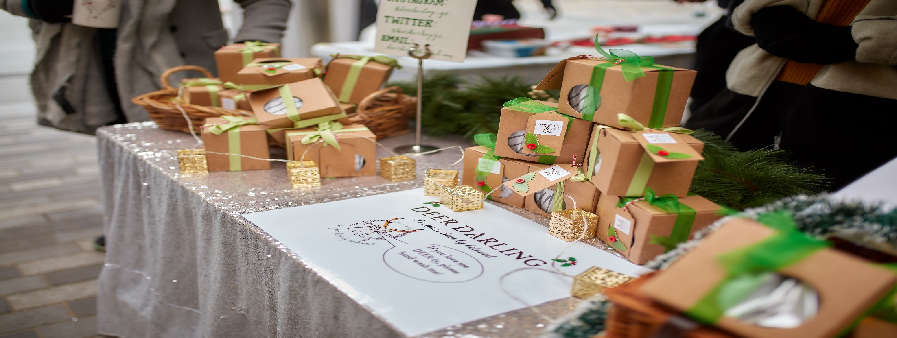
Resources and Finance

Slide 18
Resources and Finance
Questions to answer when setting up your business:
Where you will find/buy your materials/resources?
Who could help?
How much do they cost? Can you negotiate?
How much time does it take to make a product?
Is your selling price flexible and will you offer discounts for multibuy?

Slide 19
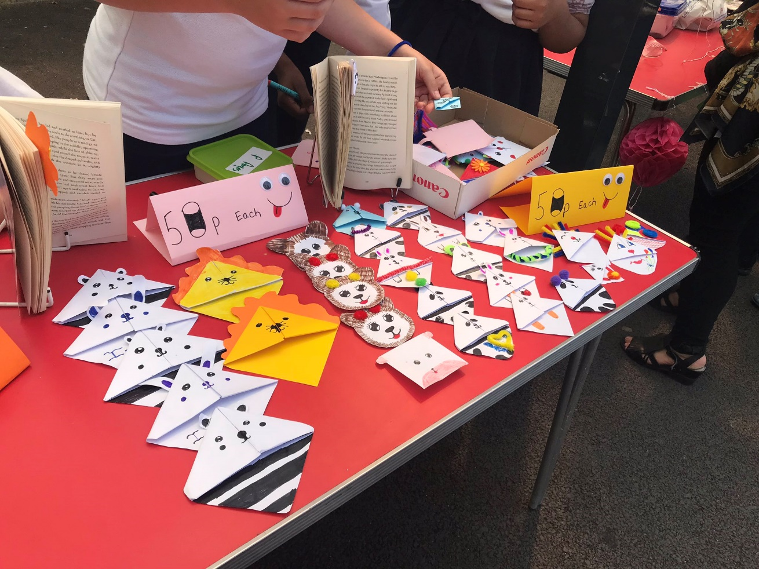
Advertising and Marketing
Notes:
Advertising and marketing is how a company encourages people to buy their products, services or ideas.

Slide 20
Advertising and Marketing
How can you promote your product/service?
Pop up shop/join an event
Sell at a local market
Get in touch with your local community and press
Local radio

Slide 21
Weekly Fiver Challenge
Competitions
Friday 11th June
Friday 18th June
Best Logo
Submit your Fiver business logo
Best Sales Pitch
Tell us in 60 seconds why we should invest in your business
The winning entry for each competition will win a £50 Amazon voucher and feature in the Fiver National Competition finals.
Notes:
A logo is is a symbol or picture that a company uses to let people know that a product or service is made by them. Like the Nike tick.
A sales pitch is a presentation that explains why investors should give their money to the presenter’s business.
There are a maximum of 5 entries per school for each competition.

Slide 22
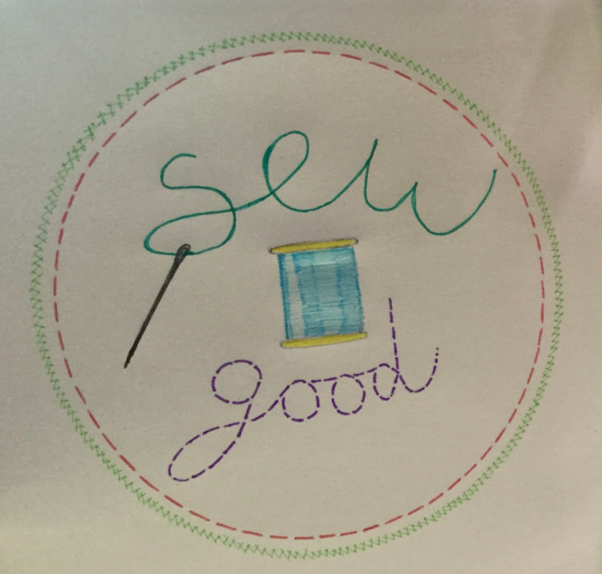
Last year’s logo winner:
Tie 5
Notes:
Ask the students what they like about the logo.

Slide 23
Last year’s sales pitch winner:
Tie 5
Notes:
Ask the students to ask what they liked about the sales pitch.

Slide 24
National Fiver Challenge Competition
Entry for the National Competition is split into two different age groups:
Age 5 to 8
Age 9 to 11
Award Categories:
Best Team
Fiver for Good
Best in Sustainability
Most Inspiring Individual
Highest profit
The winners will get a prize and be invited to attend an awards ceremony in September.
Notes:
There are a maximum of 5 entries per school

Slide 25
Top tips from young entrepreneurs
Notes:
Before we finish the session lets hear some advice from some young entrepreneurs that you can use in your Fiver Challenge.

Slide 26
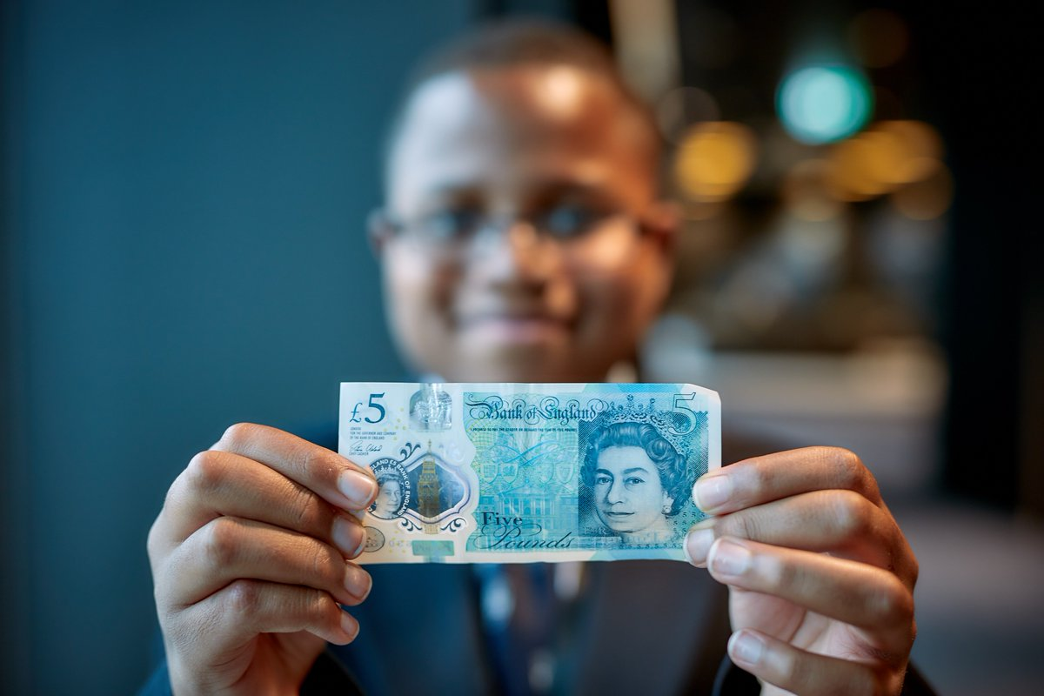
Fiver Challenge – it’s up to you!

